Slide 2
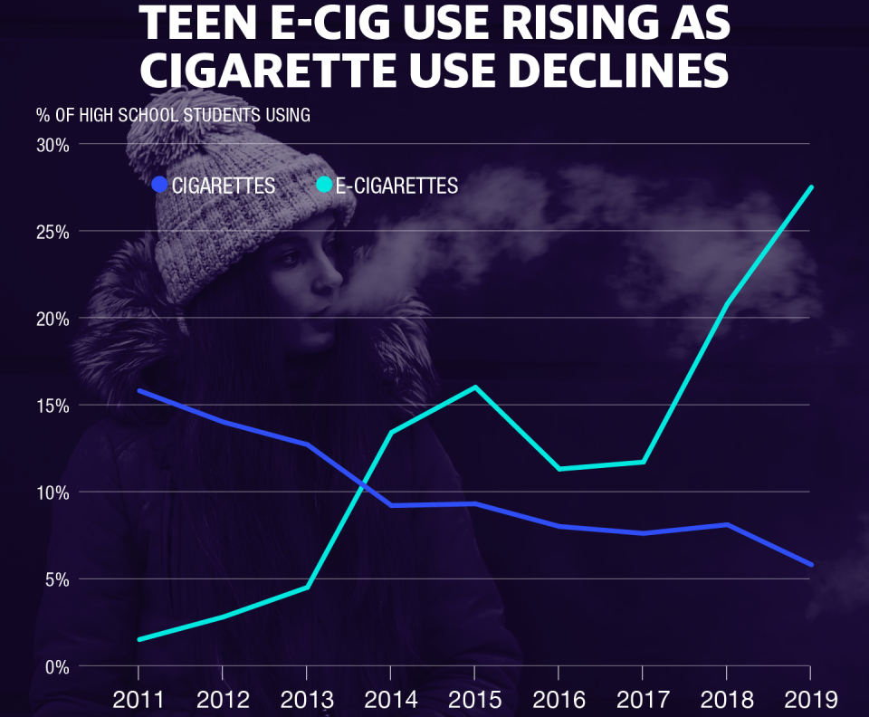
Notes:
Which brings us to the Youth Vaping Epidemic currently gripping our nation and our State. Here is a graphic comparing high school students’ use of cigarettes represented by the dark blue line, vs. high school students’ use of e-cigarettes represented by the light blue line over the years starting in 2011 up to 2019. This is the national trend. Cigarette use by high school students nationally fell from 16% in 2011 to about 6% in 2019. This is a great trend reflecting the effects of years comprehensive approaches to tobacco regulation including smoke-free air laws, restricted marketing and advertising, restrictions on accessibility, along with educational campaigns. In the late 1990’s the prevalence among high school students was in the 30% range. E-cigarettes first hit the market in 2007 and by 2011, about 2% of high school students were using e-cigarettes. As you can see by following this trend, the prevalence has grown to 28% in 2019. A youth vaping epidemic was declared in 2018 by both the Surgeon General and Director of the FDA when the prevalence passed 20%. Let’s see how Hawaii stacks up against the national figures.
https://www.cdc.gov/tobacco/data_statistics/surveys/nyts/index.htm

Slide 3
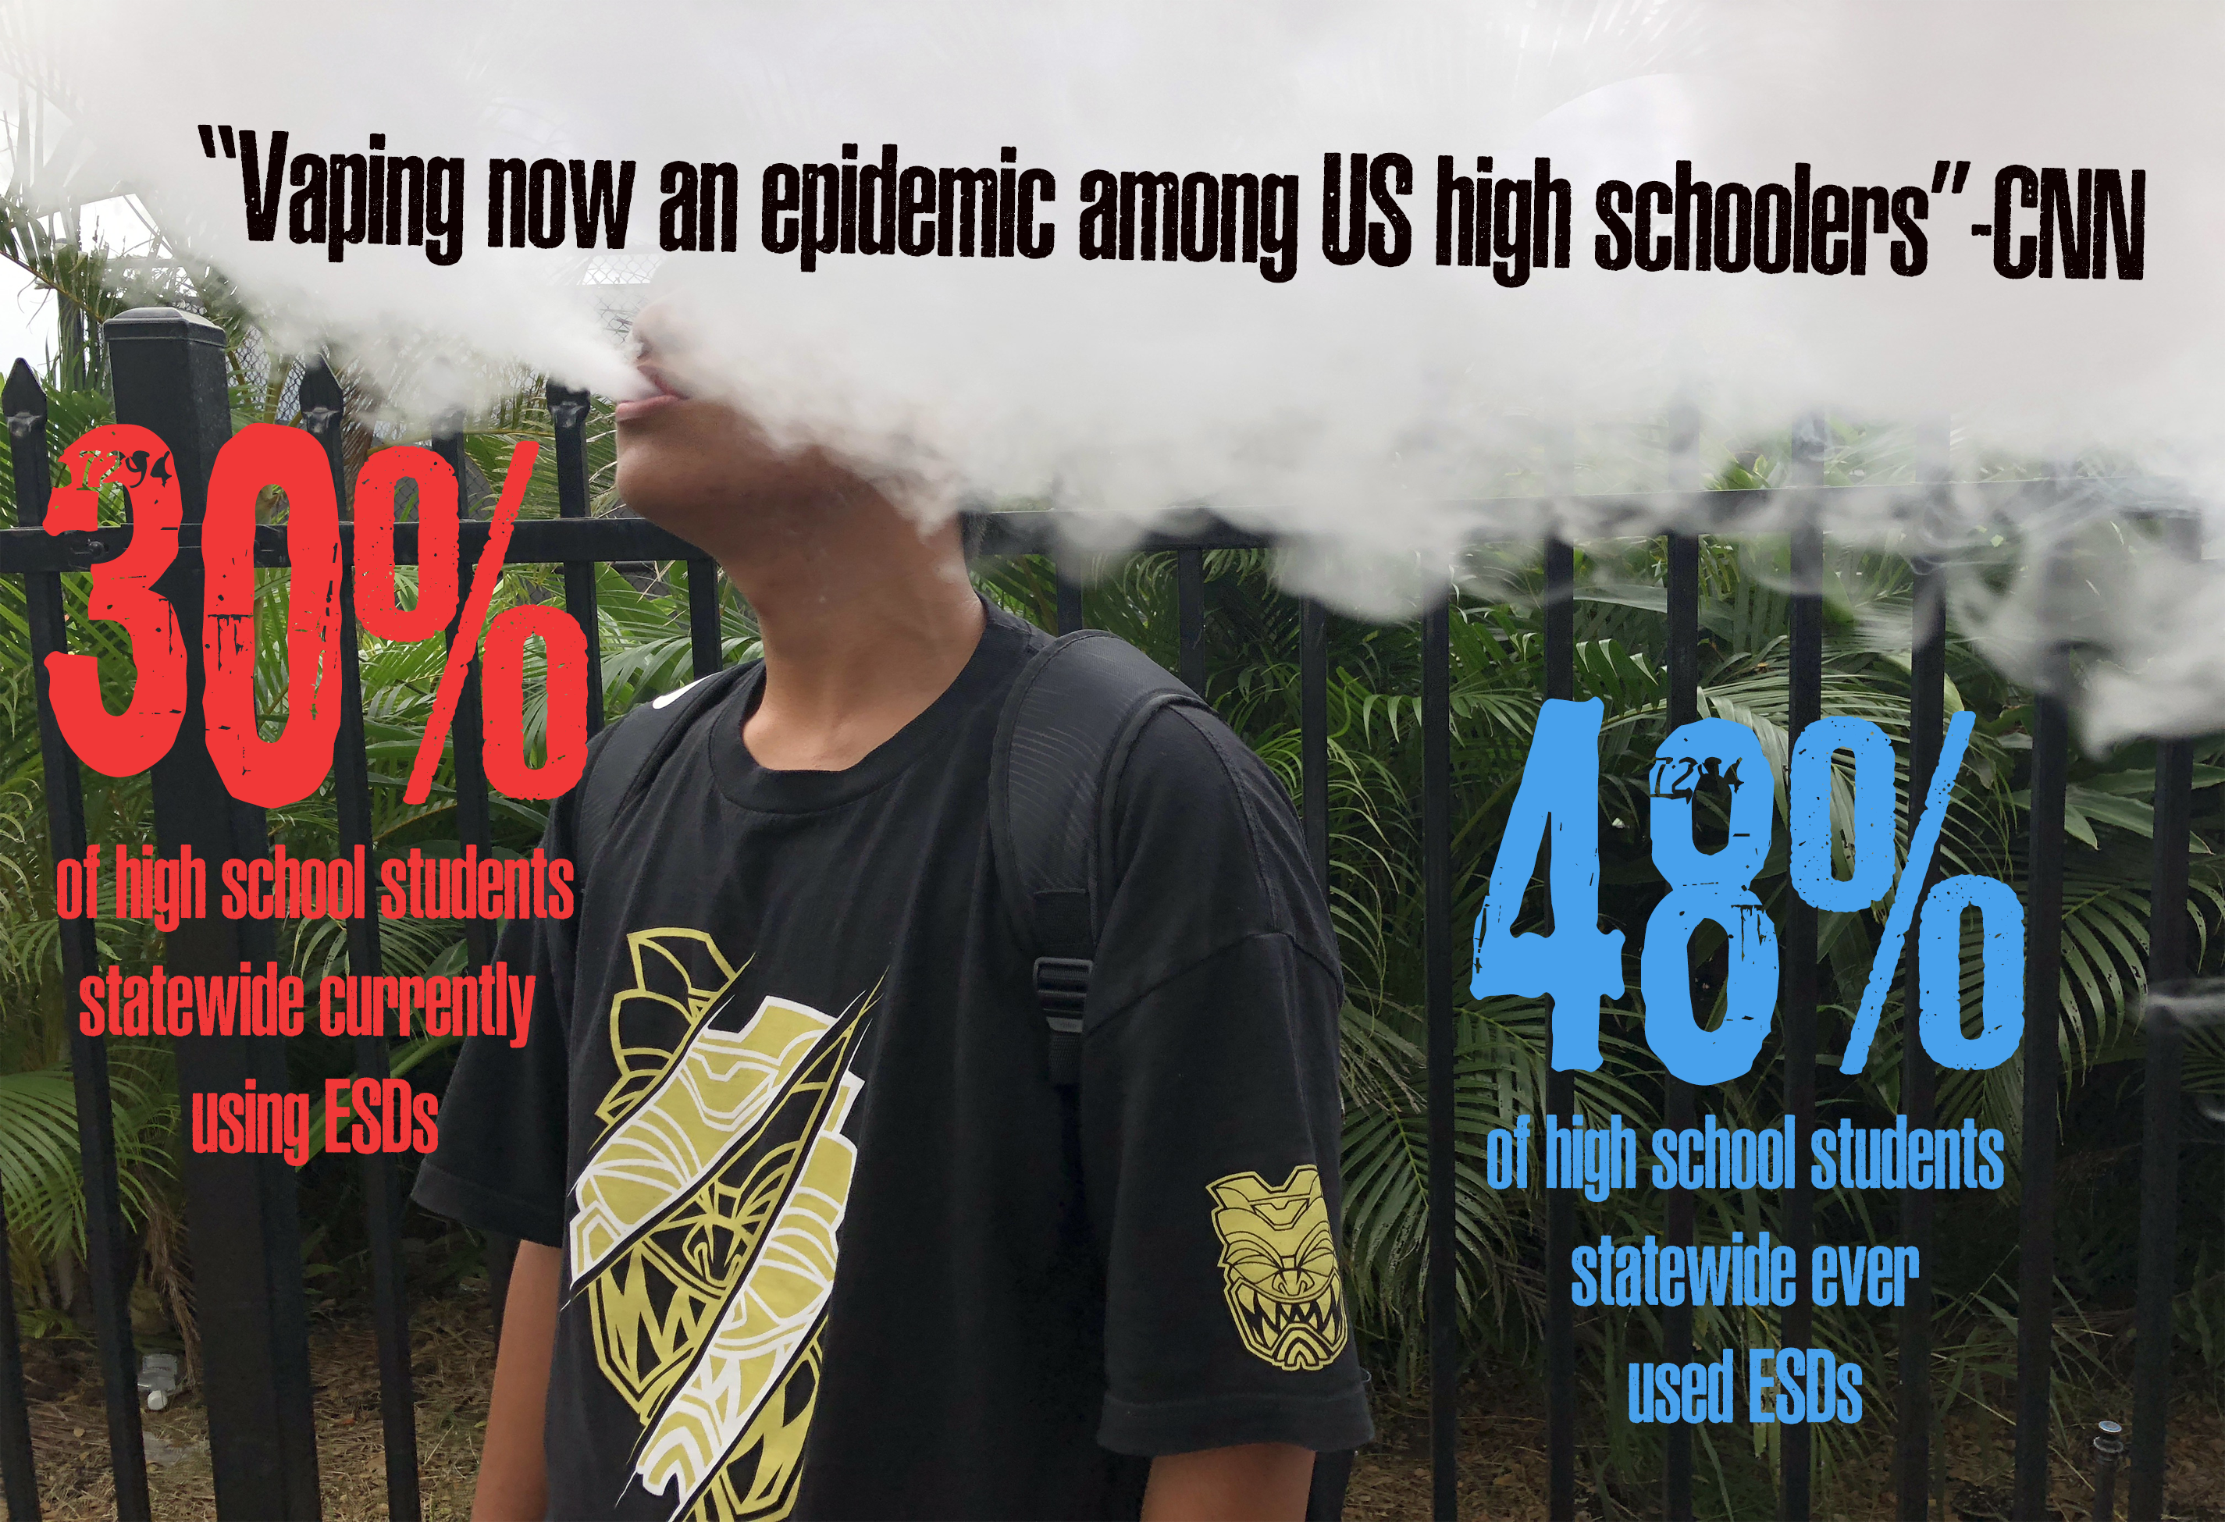

Slide 4
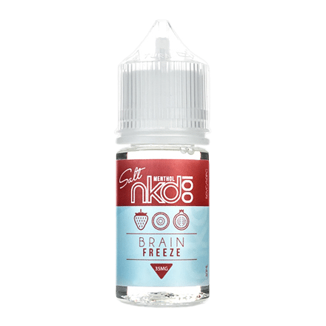
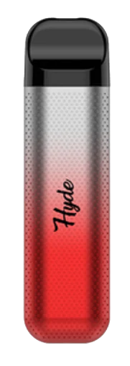
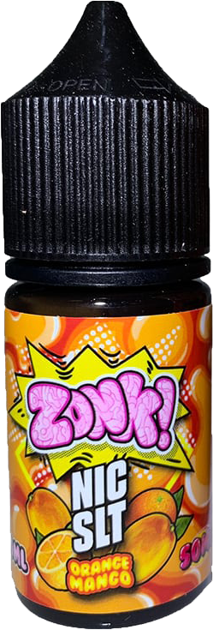
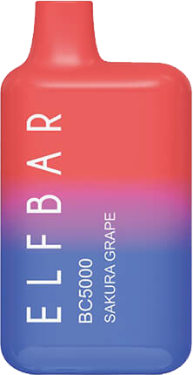

Slide 5
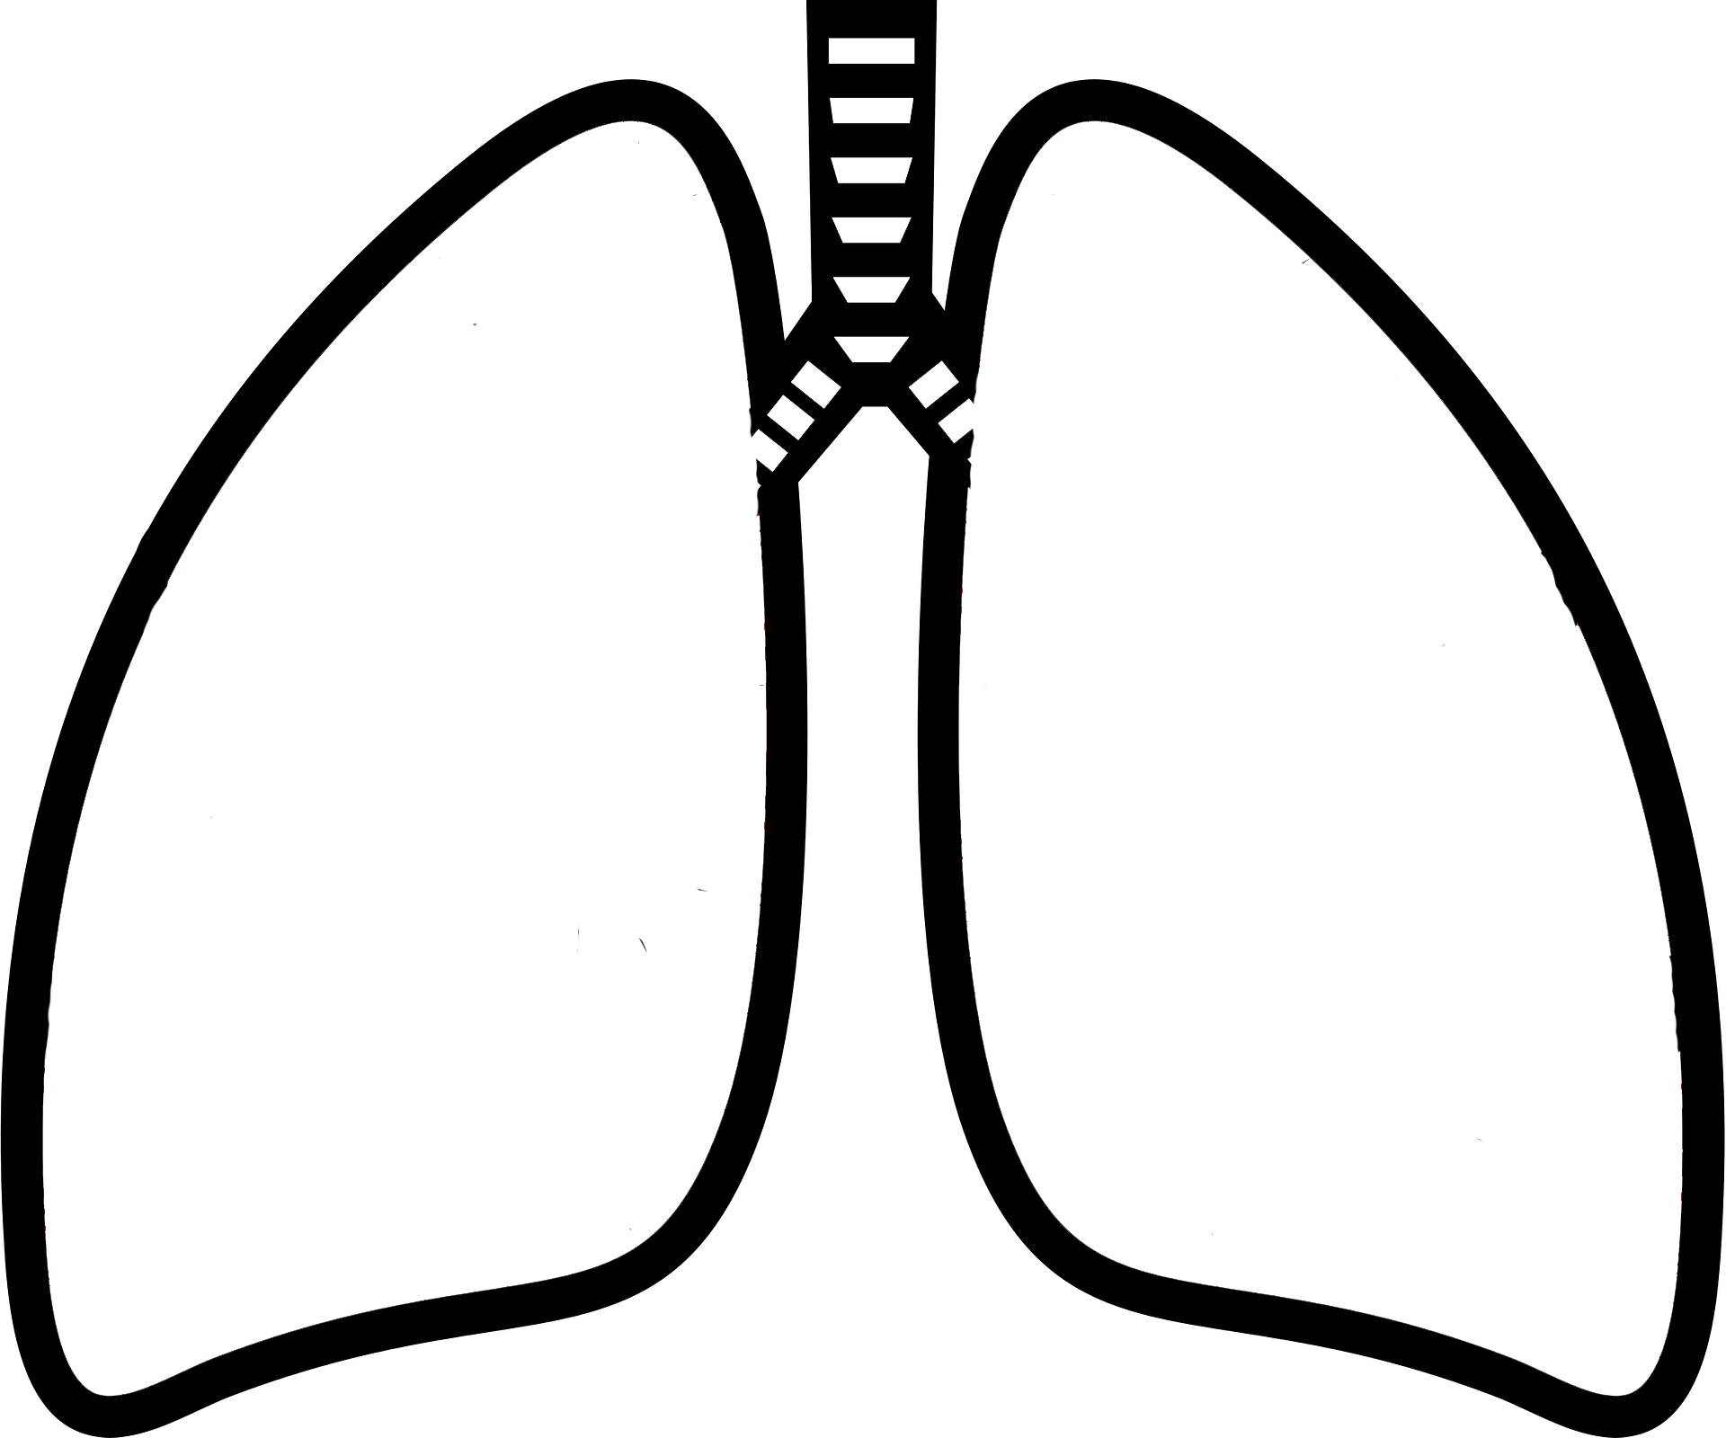
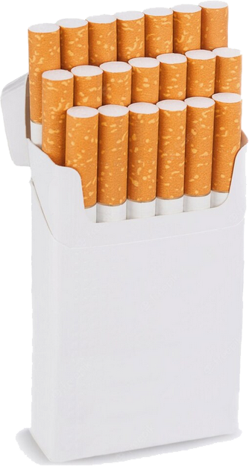
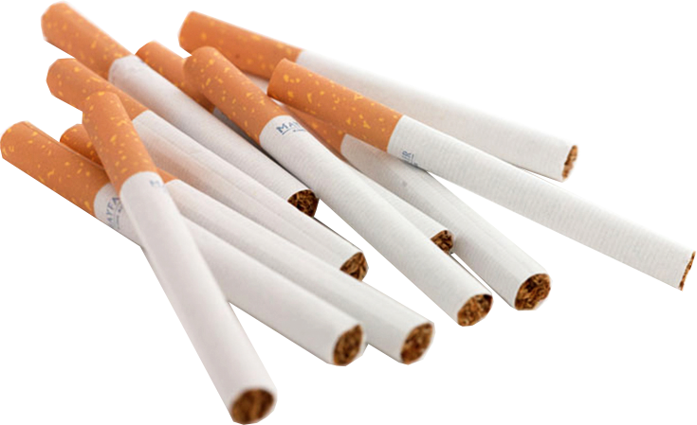

Slide 6
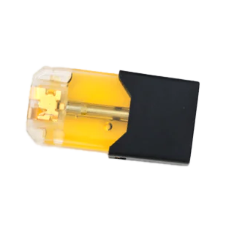
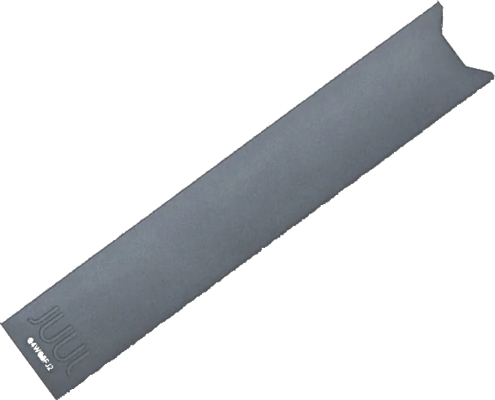
Notes:
1 JUUL pod (.7ml) = 41.3mg of nicotine (5%)

Slide 7
Notes:
Aloha Sun 5% is 8ml, 3000 puffs = 400 mg of nicotine; 360 cigarettes; over 18 packs

Slide 8
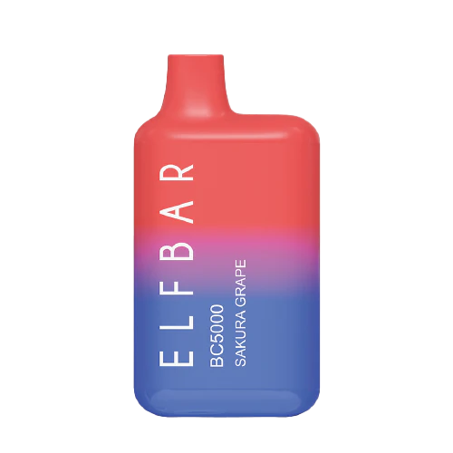
Notes:
Elf Bar5% is 13ml, 5000 puffs = 650 mg of nicotine; 590 cigarettes or 30 packs!

Slide 9
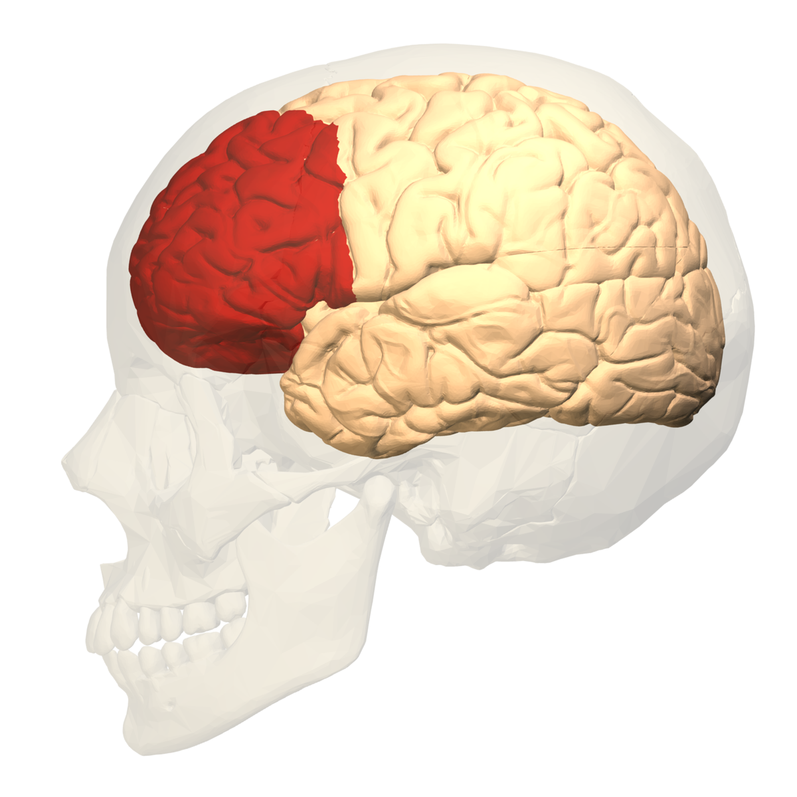

Slide 10
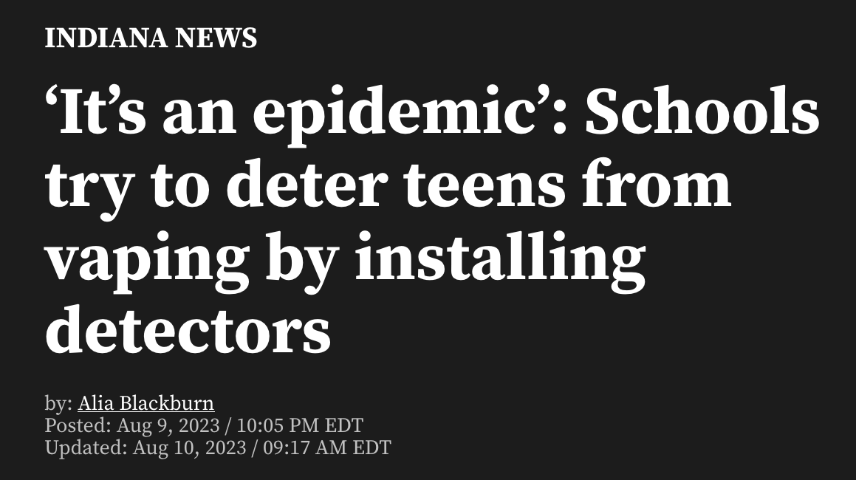
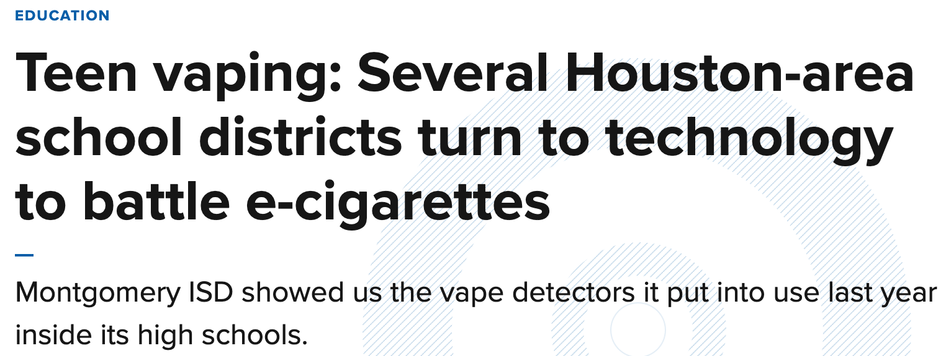

Slide 11
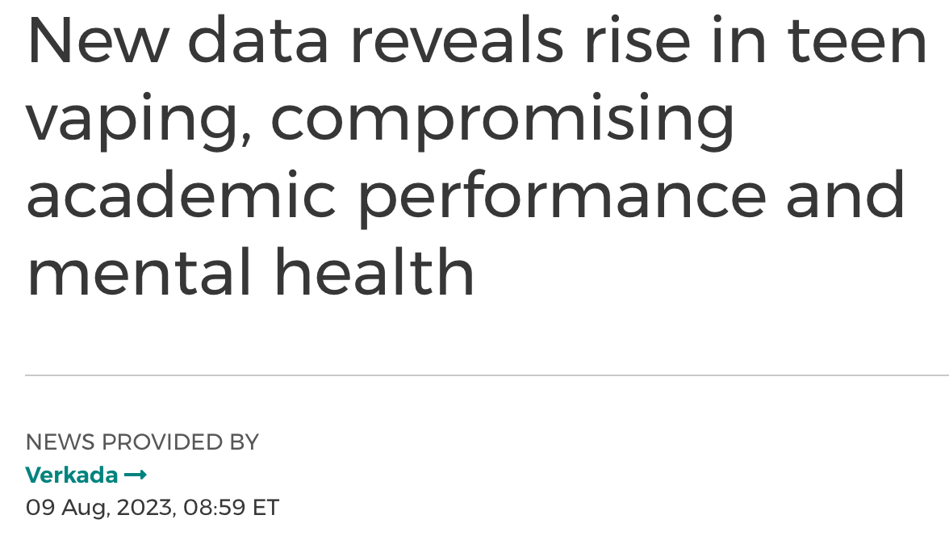

Slide 12
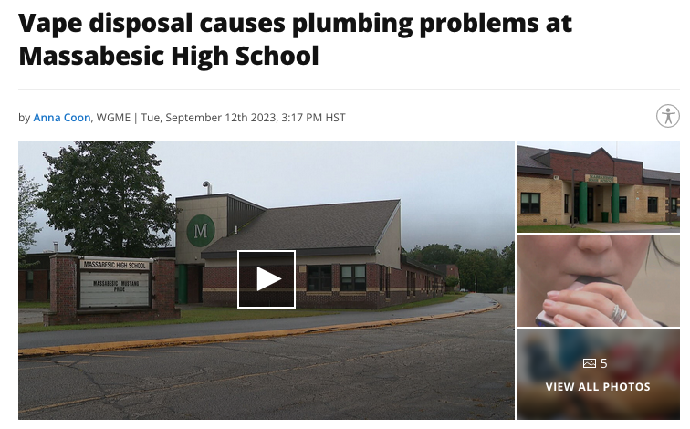

Slide 13
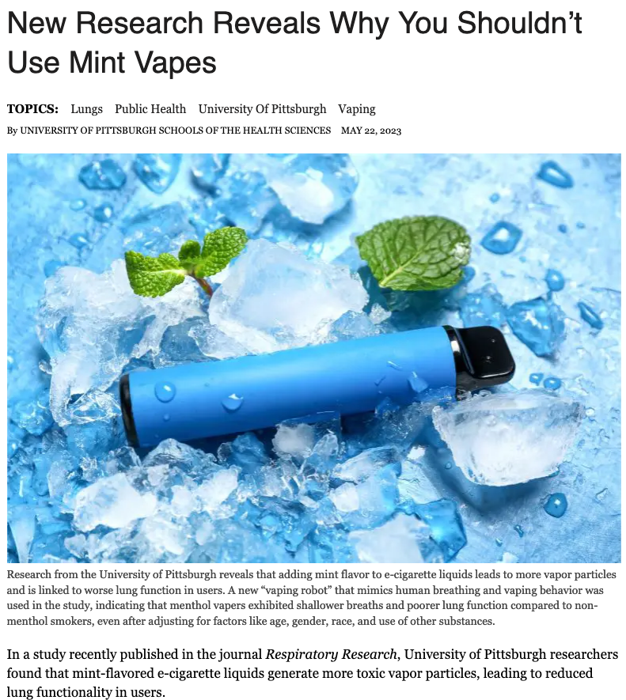
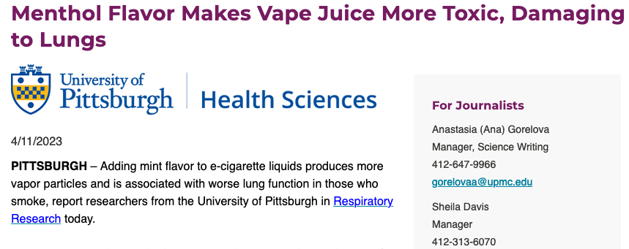

Slide 15
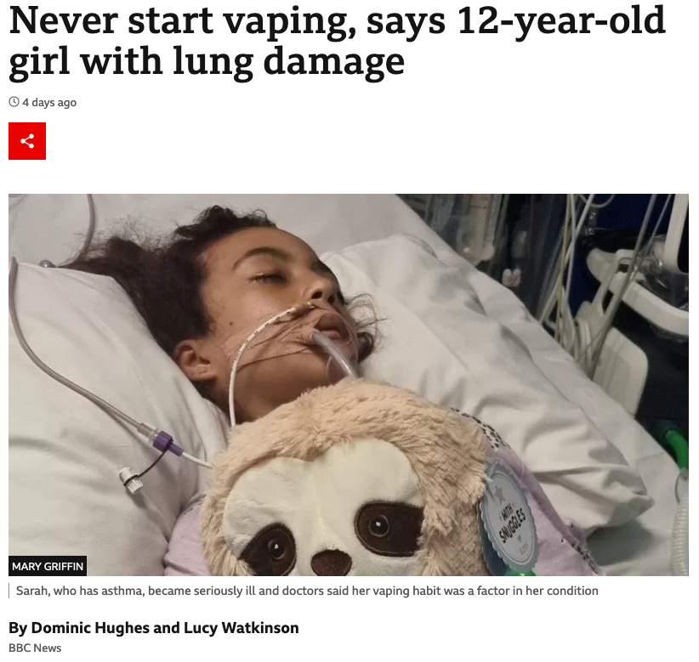

Slide 17
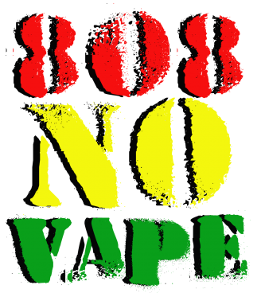

Slide 18
